Slide 1
Gradient Boosted Machine Learning Trading Strategy
By Pradyum Chitlu

Slide 2
20 Day Moving Averages - Simple (support/resistance) and Exponential (recent prices weighted more)
Bollinger Band - dynamic ranges that adjust to volatility
Average True Range (ATR) - indicates volatility levels
Relative Strength Index (RSI) - overbought/oversold indicator
MACD (Moving Average Convergence Divergence) - signals momentum shifts
Technical Indicators Used

Slide 3
Machine Learning Forecasting Model
Gradient Boosting Regressor predicts the next days price after being trained on prior data.
Feature Engineering
Timeframe
Lag Features: Price values from the previous 1–5 days. Technical Indicators: 20-day SMA, EMA20, RSI, MACD histogram, and Bollinger Band width.
These features are derived from historical data (6 months of daily prices).
Training Process
Evaluation Metrics
The model is trained on data with the target defined as the next day’s change in price.
Forecasts are produced by adding the predicted change to the last observed price.
Performance metrics such as Mean Absolute Error (MAE), Root Mean Squared Error (RMSE), and the Coefficient of Determination (R²) are calculated.

Slide 4
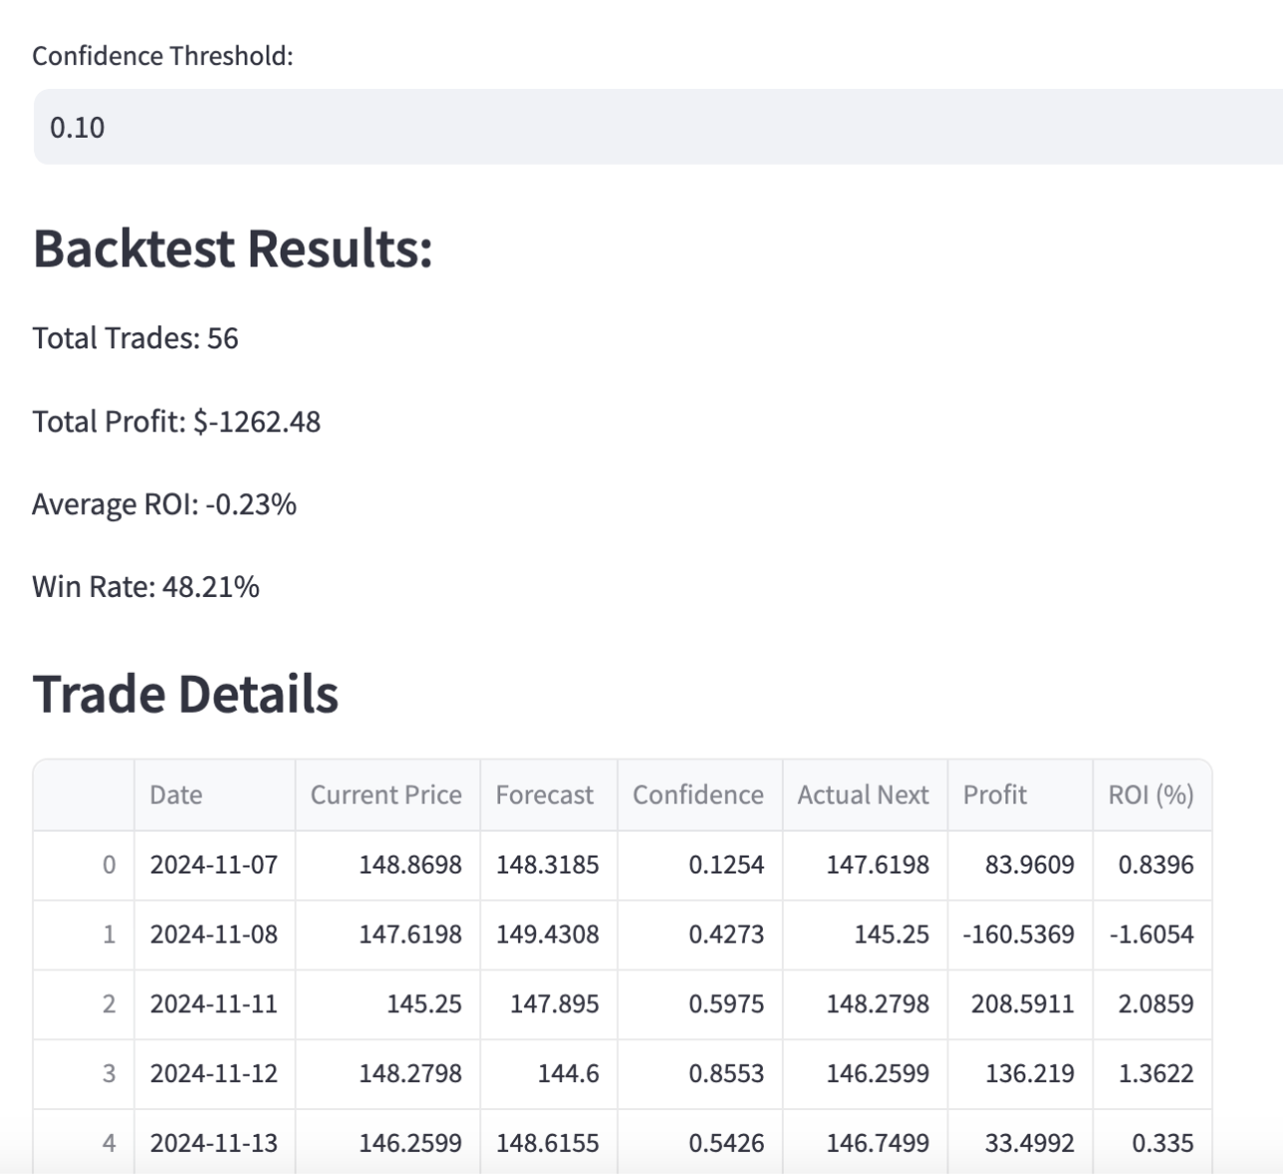
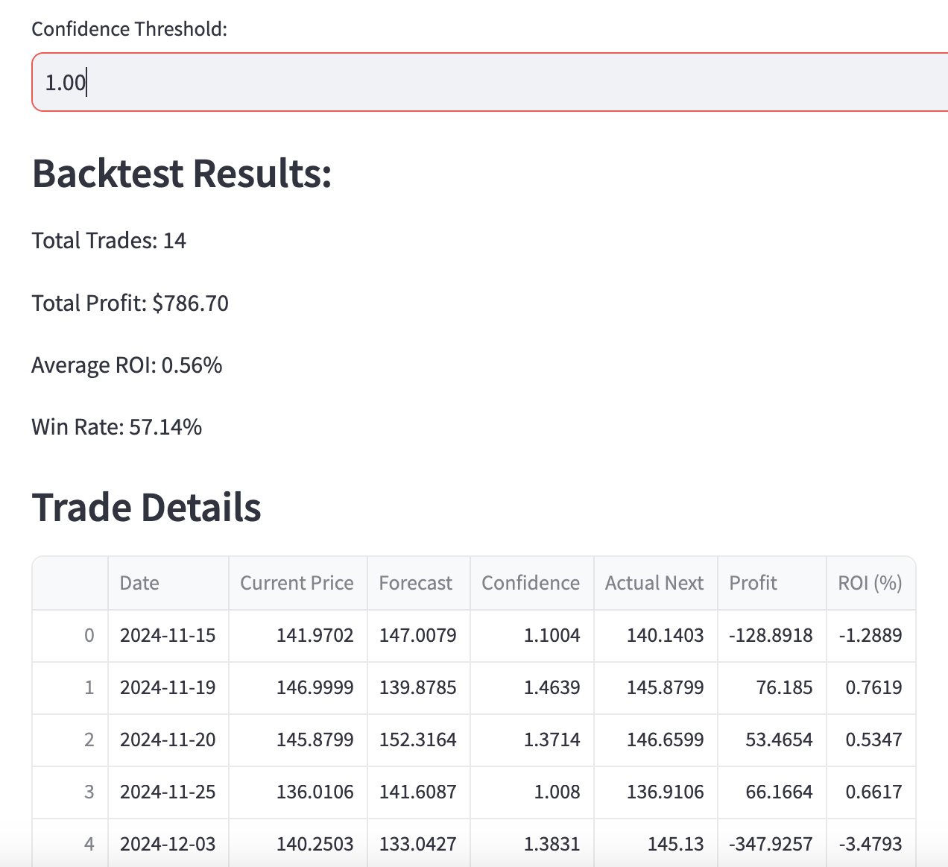
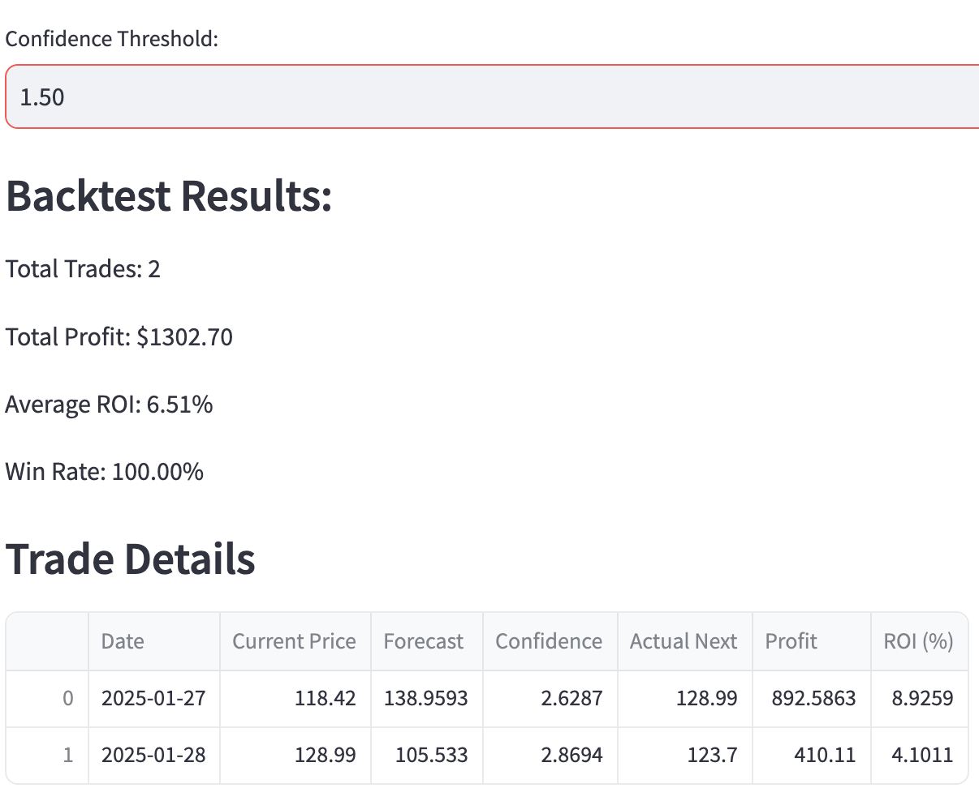
Example when changing the confidence level with Nvidia, the average ROI per trade was better.
Calculations are based on a starting with an initial capital of $10000.
Backtesting Results
01
Date Range
Last 6 months of prices.
02
Daily Simulation
Starting from day 60, simulates trades each day, and the model is re-trained including that day to predict the next day.
03
Trade Signal
A long is signalled if the forecast is higher than the current price, short if lower.
04
Confidence Threshold
Trades are executed only if this confidence value exceeds a user-defined threshold.
Confidence = (Forecast Price - Current Price) / (ATR)

